Slide 1
Frequency Space and Fourier Transforms
Eric Prebys

Slide 2
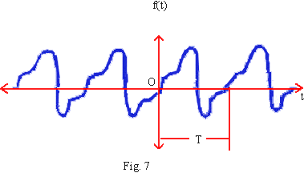
Discrete Transformations
In general, we can express any periodic function as sum of sines and cosines
Fourier Series

Slide 3
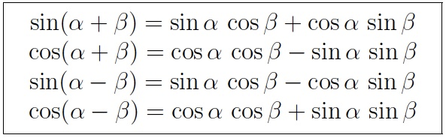
Reminder: Sum and Product Rules

Slide 4
Extracting the Coefficients
Fourier Transform

Slide 5
Example: Square Wave

Slide 6
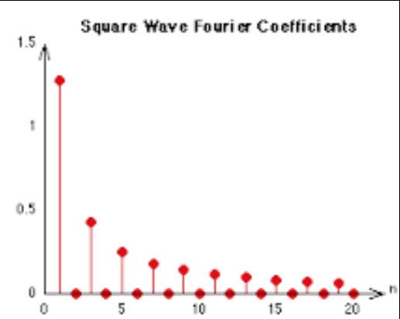
Example: Square Wave

Slide 7
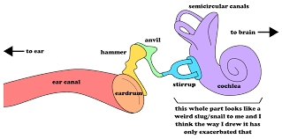
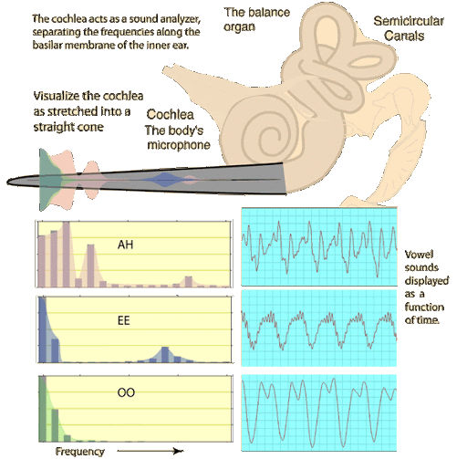
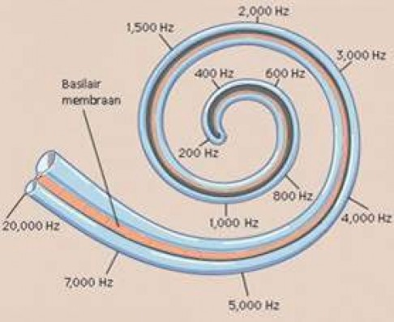
The Ear and Fourier Transformations

Slide 8
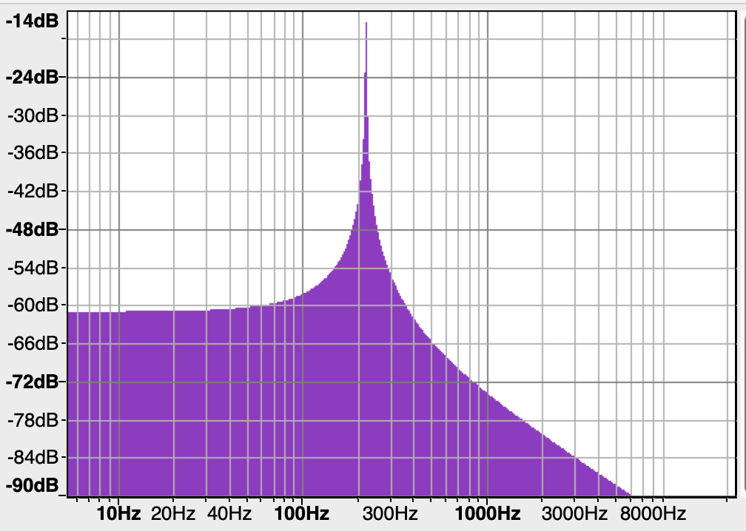
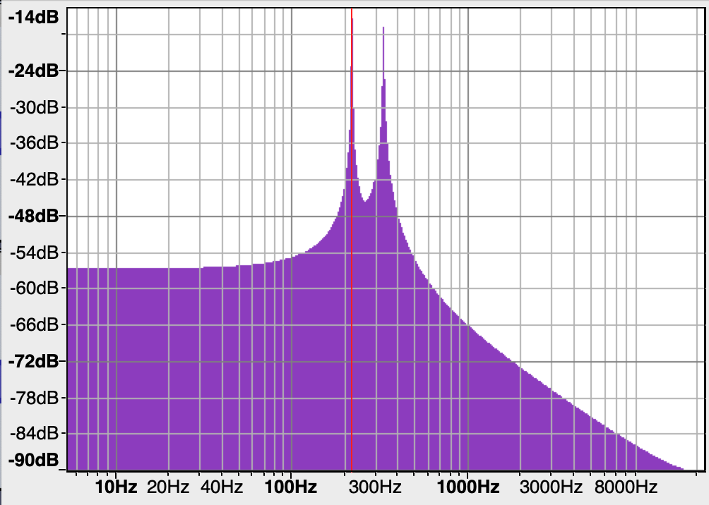
Perception of Hearing
Because of the way the ear works, we do not directly sense the motion of the ear drum, but we do sense the individual frequency components of the sound, with very high precision.
  This allows us to hear individual notes:
A₃ (220 Hz)
Perfect 5th (220Hz+330 Hz)

Slide 9
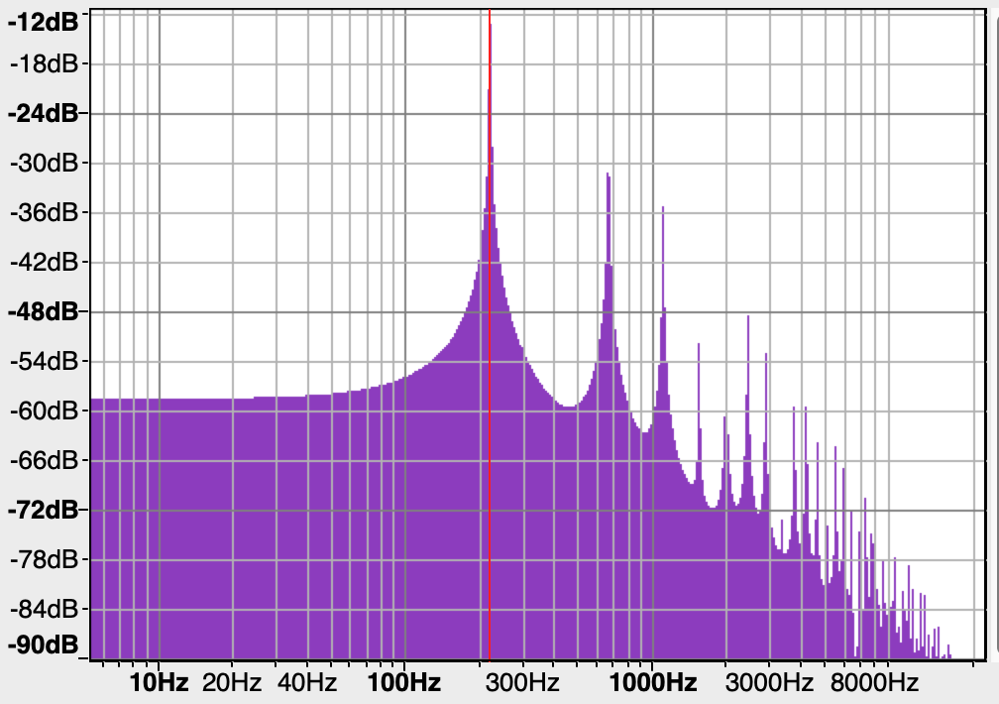
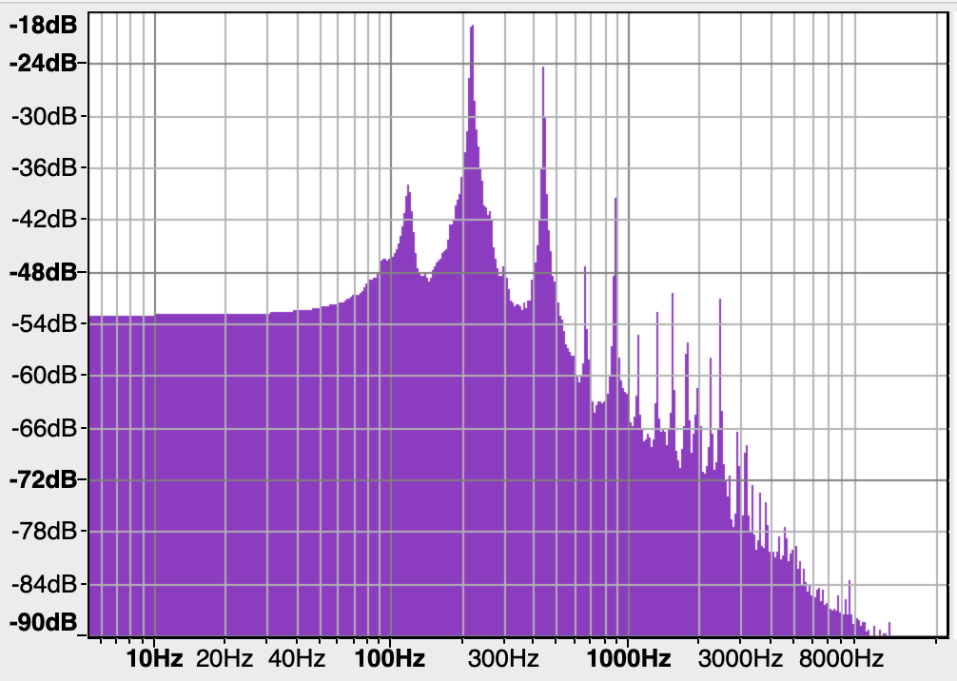
Spectral content (overtone series) also determines how a note sounds to us.
Open A string vibrating in sympathy
Note: only odd harmonics!
Strong 2nd Harmonic
A₃ (220 Hz sine wave)
220 Hz square wave
A₃ on Les Paul played through a really lousy amp.

Slide 10
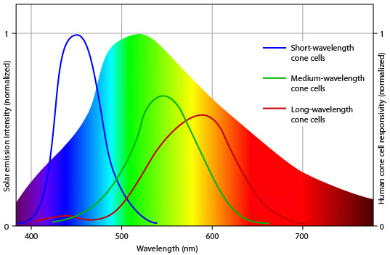
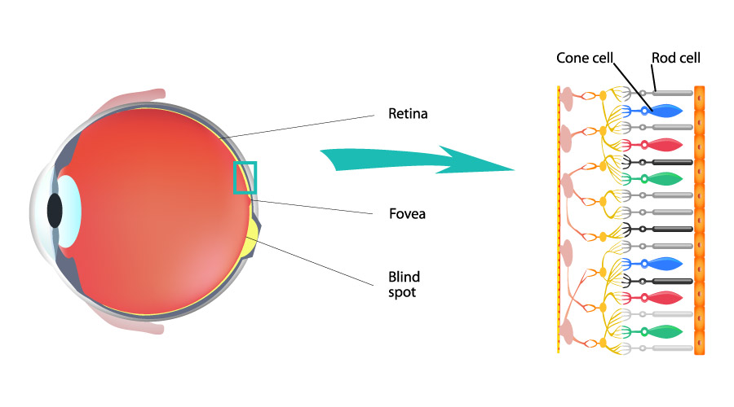
Digression: How We See Color
Our perception of color is also based on frequency, but unlike sound, we don’t distinguish individual colors.
For each point, we perceive a single color based on the relative stimulation of the three types of color-sensitive “cones” in our retinas.
Projectors and displays mimic colors using combinations of red, green, and blue.
blue+green=cyan
red+green=yellow
“red” cones are also sensitive to violet, thus
red+blue=violet
red+green+blue=white

Slide 11
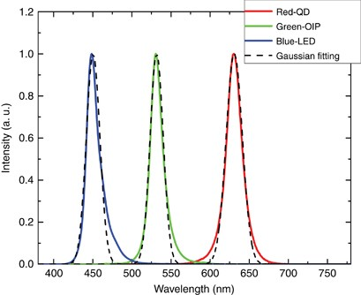
No image shows ”true” colors
Example: If I take the from a helium discharge tube and put it through a diffraction grating, I’ll see well defined lines corresponding to individual wavelengths
On the other hand, if I take the
color “yellow” that I’m projecting
here and pass it through a
diffraction grating, I’ll see the
spectra of the green and red
LEDs
Fish and some birds have a fourth shorter wavelength cone, so they would not see an RGB projection of violet as the same as pure violet.

Slide 12
Complex Representation
If result is real, then

Slide 13
Power in the Fourier spectrum
We’re generally interested in average power as a function of frequency, and in general
We need to be careful when dealing with nonlinear functions of complex representations, because in general

Slide 14
Power (cont’d)
In our frequency representation
In other words, the power spectrum has the same spectral content as the amplitude spectrum

Slide 15
Discrete Fourier Transformation
If we have N time domain samples over a time T, the time between samples will be
This will correspond to N frequency domain, with a frequency step
That is, the minimum frequency would be one in which the period is the entire time of acquisition.
The maximum frequency would be
Nyquist’s theorem tells us we can only use up to half of this frequency, to the extra information is for phase values.

Slide 16
Fast Fourier Transforms (FFTs)
In order to find the Fourier Coefficients using integration, we would have to integrate N time domain points for each of the N frequency values, so the computation time would go as N²
Luckily, there’s an algorithm called “Fast Fourier Transform”, for which the time goes like log(N).
The FFT tool in Python is np.fft.fft.
  In general, this takes N complex time domain values and returns N complex frequency domain values, corresponding to
  Because we usually deal with real values in the time domain
  Since we’re generally only interested in the positive values, the the returned values are in the order

